Slide 1

第4章 可判定性
本章内容及要求：
Decidability ep151 cp104
  decidable languages are languages that can be decided by TM (that means, the corresponding TM will accept or reject correctly, never loops)
    we investigate some decidable languages that are related to DFA, NFA, and CFG
      Testing Acceptance, Emptiness, or Equality
    we show how TM can simulate CFG
  Undecidable problem
    Uncountable set
    对角线方法-powerful tool to show a language is undecidable
    Examples of undecidable Language:
      Turning recognizable but not decidable: Halt problem
      Non-Turning recognizable

Slide 2
Decidable Languages

Slide 3


Recall that:
A language is Turing-Acceptable
if there is a Turing machine
that accepts
Also known as: Turing-Recognizable
or
Recursively-enumerable
languages

Slide 4



For any string :
halts in an accept state
halts in a non-accept state
or loops forever

Slide 5

Definition:
A language is decidable
if there is a Turing machine (decider)
which accepts
and halts on every input string
Also known as recursive languages

Slide 6
For any string :
halts in an accept state
halts in a non-accept state
Every decidable language is Turing-Acceptable

Slide 7
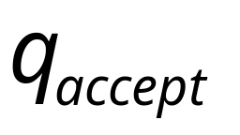
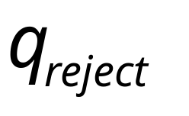
Sometimes, it is convenient to have Turing
machines with single accept and reject states
These are the only halting states
That result to possible
halting configurations

Slide 8



We can convert any Turing machine to
have single accept and reject states
New machine
Old machine
For each tape symbol
Multiple
accept states
One accept state

Slide 9



Do the following for each possible
halting state:
New machine
Old machine
For each
For all tape symbols
not used for read in the
other transitions of
Multiple
reject states
One reject state

Slide 10

For a decidable language :
Decision
On Halt:
Decider for
Accept
Input
string
Reject
For each input string, the computation
halts in the accept or reject state

Slide 11
For a Turing-Acceptable language :
Turing Machine for
Input
string
It is possible that for some input string
the machine enters an infinite loop

Slide 12


Problem:
Is number prime?
Corresponding language:
We will show it is decidable

Slide 13


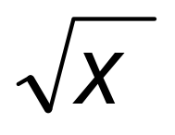

Decider for :
On input number :
Divide with all possible numbers
between and
If any of them divides
Then reject
Else accept

Slide 14

the decider for the language
solves the corresponding problem
Decider for PRIMES
YES
Input number
is prime?
(Accept)
(Input string)
NO
(Reject)

Slide 15



Theorem:
If a language is decidable,
then its complement is decidable too
Proof:
Build a Turing machine that
accepts and halts on every input string
( is decider for )

Slide 16



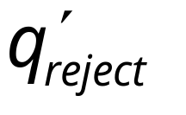
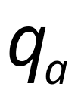

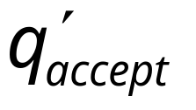

Transform accept state to reject
and vice-versa

Slide 17



Turing Machine
On each input string do:
1. Let be the decider for
2. Run with input string
If accepts then reject
If rejects then accept
Accepts and halts on every input string
END OF PROOF

Slide 18
Decidability ep151 cp104
We are now ready to tackle the question 问题:
What can computers do and what not?
计算机 能做什么，不能作什么？ 不容易直接回答
转化为 考虑下列问题
Which languages are TM-decidable, Turing-
recognizable, or neither?
那些是图灵可识别，可判定或都不是? 容易多了
Assuming the Church-Turing thesis, these are
fundamental properties of the languages.

Slide 19
A computational problem is decidable
if the corresponding language is decidable
We also say that the problem is solvable

Slide 20
问题的引入
讨论DFA的特征：
给定DFA和w，查找算法判断：
  DFA接受w，或者DFA拒绝w
给定DFA，查找算法判断
  L(DFA)={}，或者L(DFA)≠{}
给定DFA1，DFA2,查找算法判断
  L(DFA1)=L(DFA2)，或者
  L(DFA1) ≠ L(DFA2)

Slide 21


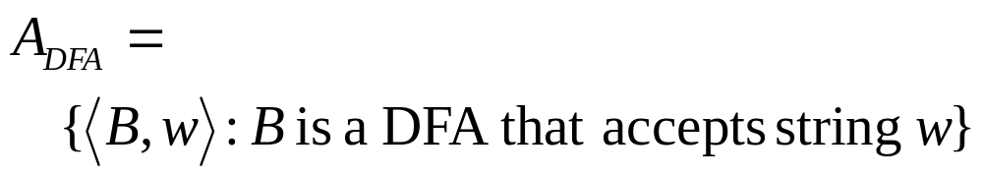
Problem:
Does DFA accept string ?
Corresponding Language:
(Decidable)

Slide 22
Deciding Regular Languages
定理4.1 ep152, cp104
A_{DFA} = { <B,w> | B is a DFA that accepts w }
where <B, w> denotes the encoding of B followed by w
E.g., if D is a DFA accepting even length strings, and D’is a DFA accepting odd length strings, then, <D, 01>, <D, 0000>, <D’, 1>, <D’, 111> are strings in A_{DFA} , but <D, 1>, <D, 000>, <D’, 1000>,<D’, 11> are not

Slide 23
A_{DFA} is Decidable (Thm. 4.1) ep 152 cp104
直观解释
通过用C语言模拟DFA 和 TM,易知，DFA是特殊的简单的TM,
TM少用变量和数组，只用if ,goto,就是DFA.
TM 放弃 写和左移 功能，就是DFA
TM当然能模拟DFA
DFA 小学生，NDFA 初中生 PDA高中生，TM大学生
大学生当然能作小学生的作业
下页形式化证明

Slide 24
A_{DFA} is Decidable (Thm. 4.1) ep 152， cp105
Proof: We construct a TM M that decides A_{DFA} as follows:
M =“On input <B,w>, where B is a DFA with
B=(Q, Σ, δ, qstart, F) and w∈Σ*. ”
Check if B and w are ‘proper’, if not: “reject”
Simulate B on w :
If the simulation ends in an accept state, M accepts input <B,w>, which means B “accept” w; otherwise reject input <B,w>, which means B “reject” w.
形式审查
内容审查

Slide 25
ADFA is Decidable (Thm. 4.1) ep 152， cp105
Simulate B on w with the help of two pointers:
P_{q} ∈ Q for the internal state of the DFA, and
P_{w} ∈ {0,1,…,|w|} for the position on the string.
While we increase P_{w} from 0 to |w|, we change P_{q} according to the input letter w_{Pw} and the transition function value δ(P_{q},w_{Pw}).
造TM，抄袭DFA状态转移,
Q1: How can M perform the above steps??
Q2: Why is M a decider for ADFA ?

Slide 26
ADFA is Decidable (Thm. 4.1) ep 152， cp105
Q1: How can M perform the above steps??
M uses 3 tapes; initially, Tape 1 stores the input <B, w>, the other two all blanks
Then, M copies w into Tape 2, and write the start state of B in Tape 3
Usage: Tape head of Tape 2 stores next char in w for B to read, Tape 3 stores the current state
Based on Tapes 2 and 3, M moves back and forth Tape 1 to know how B performs each transition, and update the 3 tapes accordingly

Slide 27
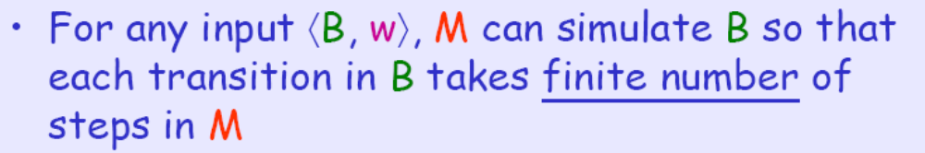
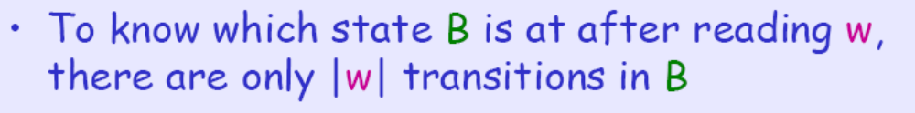
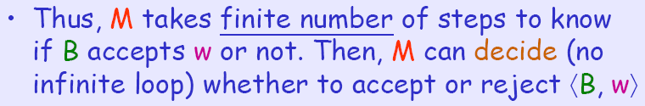
ADFA is Decidable (Thm. 4.1) ep 152， cp105
Q2: Why is M a decider for A_{DFA} ?

Slide 28
Deciding NFA 定理4.2 ep 153 ，cp105
Problem:
Does NFA accept string ?
Acceptance by NFA
Let A_{NFA} be the language
A_{NFA} = { <B,w> | B is an NFA that accepts w }
注意， A_{NFA}是 NFA 和 语言的对子 的集合，TM 能对其一分为二，并确认特征

Slide 29
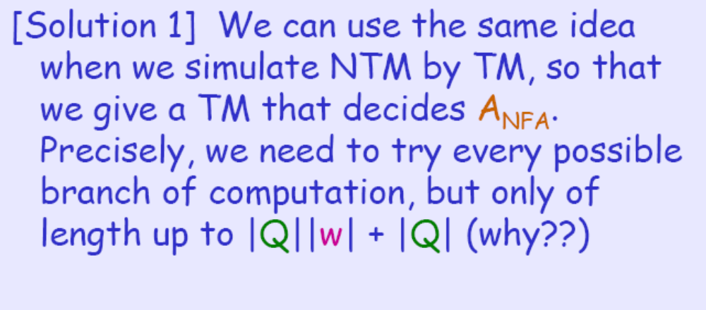
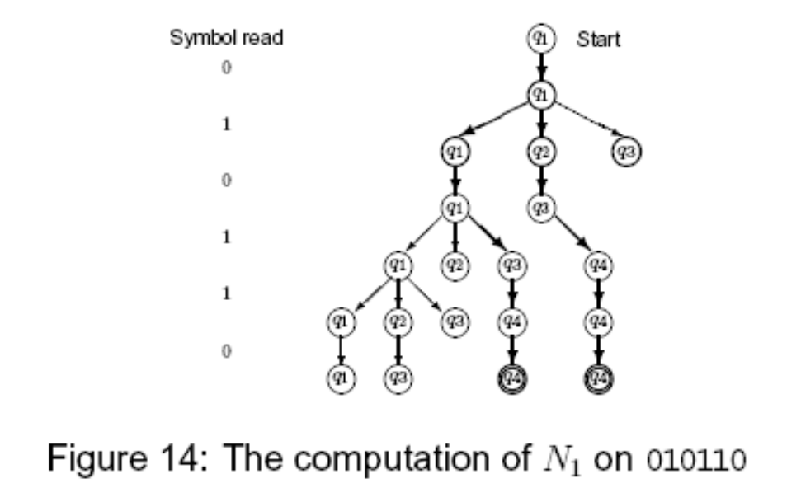
Deciding NFA 定理4.2 ep 153 ，cp105
Proof

Slide 30
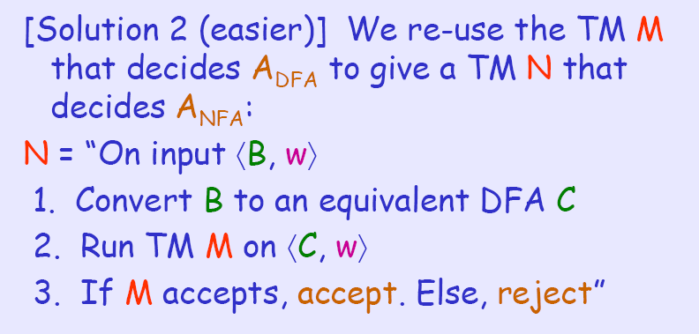
Deciding NFA 定理4.2 ep 153 ，cp105
Proof

Slide 31
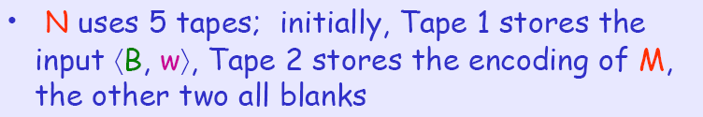
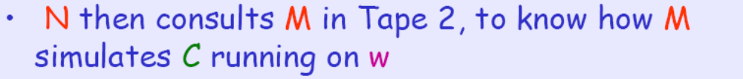
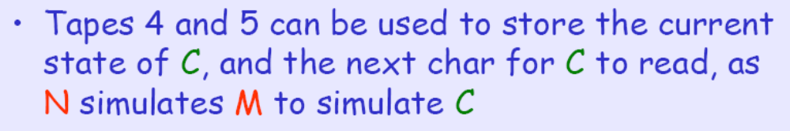
Deciding NFA 定理4.2 ep 153 ，cp105
Q1: How can N perform the above steps??

Slide 32

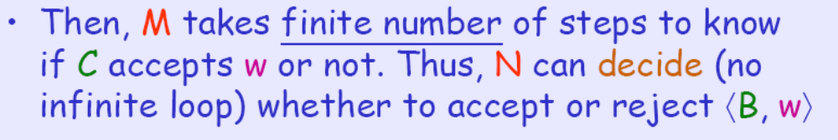
Deciding NFA 定理4.2 ep 153 ，cp105
Q2: Why is N a decider for ANFA ?

Slide 33
Deciding NFA 定理4.2 ep 153 ，cp105
Proof: Let the input <B,w> be an NFA with
B=(Q, Σ, δ, q_{start}, F) and w∈Σ*. 造TM N如下：
bool N(A_{NFA}）
{ 把 A_{NFA} 转换成 //调用自动机确定化程序
A_{DFA} ={ <C,w> | C is an DFA that accepts w }
return ( M (A_{DFA}); // 调用TM M
}

Slide 34

Acceptance by Regular Expression (RE)
定理4.3 ep154 cp105
Problem:
Does REX generate ?
Let A_{REX} be the language
A_{REX} = { <R,w> | R is a regular expression
that can generate w }
语言与正则表达式对子的集合 是否识别与被识别的关系

Slide 35
Acceptance by Regular Expression (RE)
定理4.3 ep154 cp105
Proof: W give a TM P that decides A_{REX}:
P = “On input ⟨R, w⟩
Check if R is a proper regular expression
and w a proper string //形式检查
Convert R into a NFA C // RE→NFA
Run earlier TM for A_{NFA} on <C,w>//调用前面结果
If N accepts ⟨C, w⟩, accept. Else, reject”

Slide 36

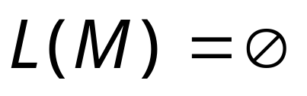
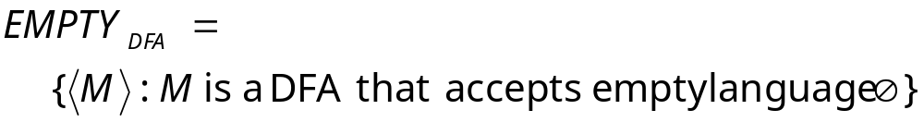

Problem:
Does DFA accept
the empty language ?
Corresponding Language:
(Decidable)
Description of DFA as a string
(For example, we can represent as a
binary string, as we did for Turing machines)

Slide 37
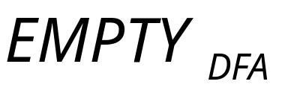
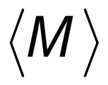

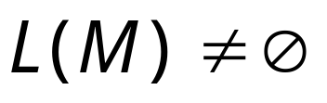

Decider for :
On input :
Determine whether there is a path from
the initial state to any accepting state
DFA
DFA
Decision:
Reject
Accept

Slide 38
Proof for DFA-Emptiness
DFA的空问题是可判定的（传销法 证明）
We use similar idea as we test if a graph G is connected. Precisely, we give a TM T that decides EMPTY_{DFA} as follows:
T = “On input <M=(Q,Σ,δ,q_{start},F)>”
If M is not proper DFA: “reject” //形式审查
Mark the start state of M
Repeat until no new states are marked
  3a. Mark any state that has a transition coming into it from a marked state
4. If no accept state of M is marked, accept. Else, reject”

Slide 39
Proof for DFA-Emptiness
DFA的空问题是可判定的（传销法 证明）
如何实现3，4步？
Make set S with initially S={ q_{start} }
Repeat :
  If S has an element in F then “reject”
  //传销到了终止态，传销路径被接受, 接受集非空
  b) Otherwise, add to S the elements that can be δ-reached from S via:
  “If ∃q_{i}∈S and ∃s∈Σ with δ(q_{i},s)=q_{j}, then q_{j} goes into S_{new}”
  //从S起，滚雪球或传销式地发展下家，发展进入S中
  If final S∩F = ∅ “accept”
  //始终没发展终止态，不接受任何语言，则是空的
  注意。现在可以用算法表示（不死循环的）图灵机了。
|Q| times

Slide 40
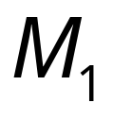
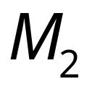
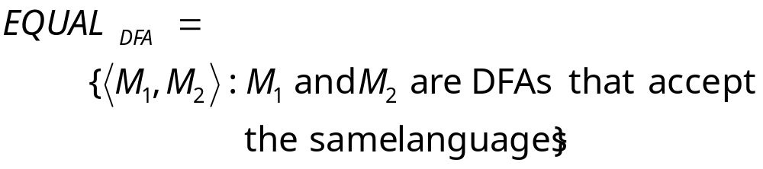
Problem:
Do DFAs and
accept the same language?
Corresponding Language:
(Decidable)

Slide 41
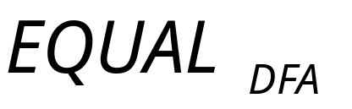
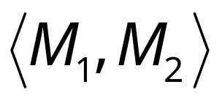

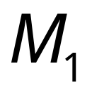

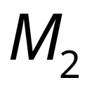

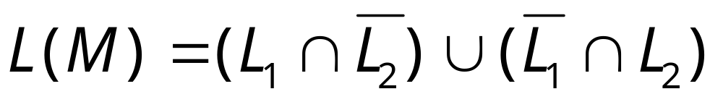
Decider for :
On input :
Let be the language of DFA
Let be the language of DFA
Construct DFA such that:
(combination of DFAs)

Slide 42
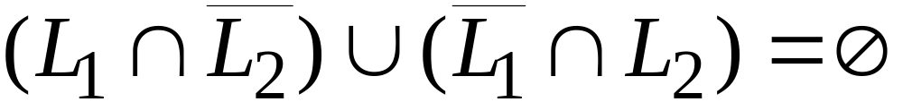
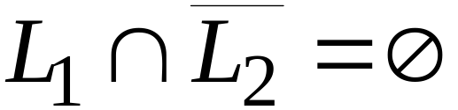
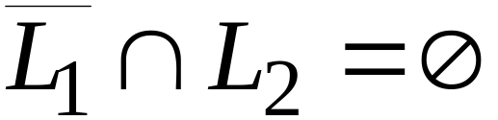


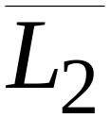
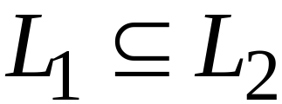
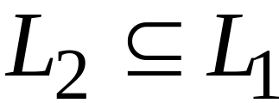
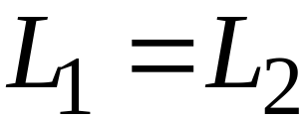
and

Slide 43
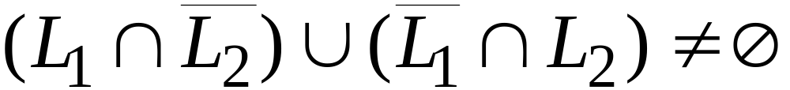
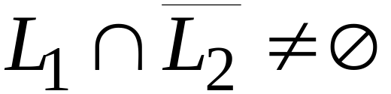
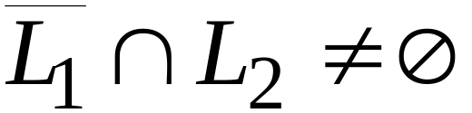
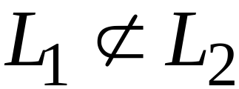
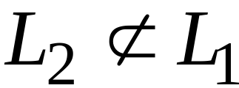
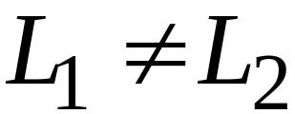
or

Slide 44
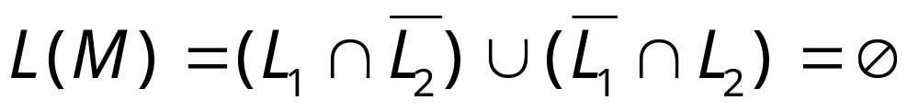

Therefore, we only need
to determine whether
which is a solvable problem for DFAs:

Slide 45
Decidable Properties of
Context-Free Languages

Slide 46
Context-Free Languages
Similar problems for context-free grammars:
ACCEPT_{CFG} = { <G,w> | G is a CFG that generates w }
生成与被生成关系 问题 A--Accept
EMPTy_{CFG} = { <G> | G is a CFG with L(G)=∅ } 空问题
E--Empty
EQULITY_{CFG} = { <G,H> | G and H are CFGs
with L(G)=L(H) } 相等问题
The key problem with CFGs and PDAs is that they
are inherently nondeterministic. 天生不确定

Slide 47


Membership Question:
for context-free grammar
find if string
Membership Algorithms:
Parsers
Exhaustive search parser
CYK parsing algorithm

Slide 48
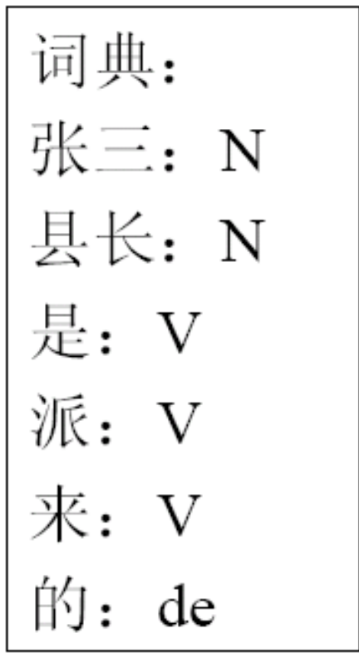
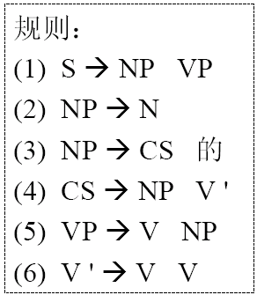
分析实例
张三是县长派来的

Slide 49
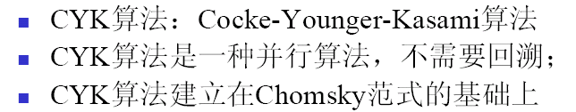
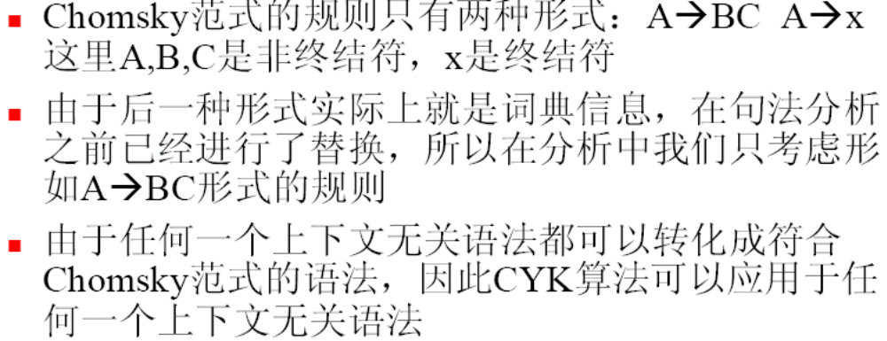
CYK算法

Slide 50
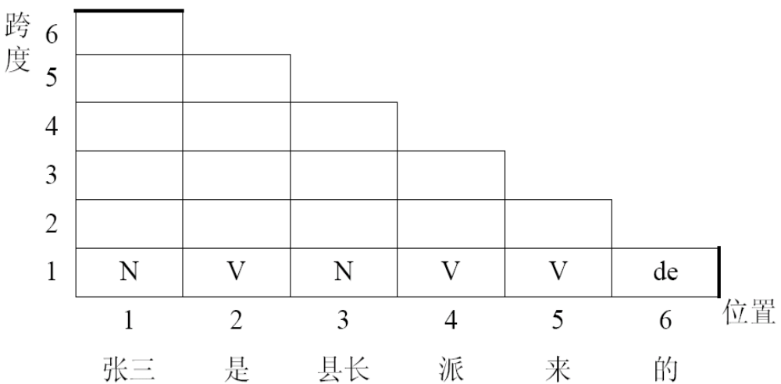
分析实例－填写第一行

Slide 51
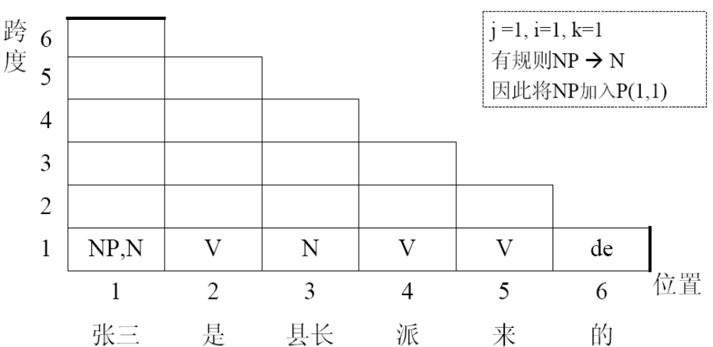
分析实例－填写第一行

Slide 52

分析实例－填写第一行

Slide 53

分析实例－填写第二行

Slide 54

分析实例－填写第二行

Slide 55

分析实例－填写第二行

Slide 56

分析实例－填写第三行

Slide 57

分析实例－填写第三行

Slide 58

分析实例－填写第四行

Slide 59
分析实例－填写第四行

Slide 60

分析实例－填写第五行

Slide 61

分析实例－填写第六行

Slide 62




Acceptance by CFG
Problem:
Does CFG produce string ?
Corresponding Language:
(Decidable)

Slide 63
Remember “Chomsky NF”? 复习
A context-free grammar G = (V,Σ,R,S) is in
Chomsky normal form if every rule is of the form
A → BC(一分为二) or A → x(终止符）
with variables A∈V and B,C∈V \{S}, and x∈Σ
For the start variable S we also allow “S → ε”
简单而不失威力，理论推导时方便
Chomsky NF grammars are easier to analyze.
The derivation S ⇒* w requires 2|w|–1 steps
(apart from S ⇒ ε). 重要：派生w的派生式长度固定。易检查。派生时步数虽多，但简单
Notes:
Proof. The first n-1 productions are of the form A → BC and get us to the correct length. The last n production are unit terminating A → a and derive x.

Slide 64

Acceptance by CFG
Proof: Perform the following algorithm:
Check if G and w are proper, if not “reject” //形式检查
//下面作内容检查:

Slide 65
Acceptance by CFG
//下面作内容检查:
2) Rewrite G to G’=(V, Σ,R,S) in Chomsky normal form //简化
Take care of w=ε case via S→ε check for G’//先处理特例
List all derivations of G’ with 2|w|–1 derivation steps
//按长度检查派生式
(Note: That is, a finite number)
4) Check any derivation generates w , “accept”; //是否有一个能派生出w
else “reject” //
Notes:
# of such derivations is less than
(4|V|| Σ|)2|w|-1.

Slide 66


Empty Language Question:
for context-free grammar
find if
Algorithm:
Remove useless variables
Check if start variable is useless

Slide 67

Removing Useless Productions
Example Grammar:

Slide 68



First:
find all variables that can produce
strings with only terminals
Round 1:
Round 2:

Slide 69


Deciding CFGs (2) cp107 倒传销方法，追究责任
Problem:
Does CFG produce
the empty language ?
Corresponding Language:
(Decidable)
Observation: Suppose that we can mark all the variables in G that can generate a string of terminals. Then, L(G) = ∅ if the start variable is not marked

Slide 70
Deciding CFGs (2) cp107 倒传销方法，追究责任
s
现在可用算法代替TM, 等价但比TM简洁
Proof: Perform the following algorithm:
Check if G is proper, if not “reject”//形式审查
Let G=(V,Σ,R,S), define set T=Σ, (Mark all terminals of G )
//从叶子开始倒查
Repeat
  Check all rules B→X₁…X_{k} in R
  If B∉T and X₁…X_{k}∈T^{k} then add B to T//倒传销,找上家
If S∈T (start variable is marked) then “reject”, otherwise “accept”//根是上家，接收
T
|V| times:

Slide 71


Infinite Language Question:
for context-free grammar
find if is infinite
Algorithm:
1. Remove useless variables
2. Remove unit and productions
3. Create dependency graph for variables
4. If there is a loop in the dependency graph
then the language is infinite

Slide 72





Example:
Infinite language
Dependency graph

Slide 73



Slide 74
Equality CFGs 意料之外的结果： 相等问题不可判定
对于科研，意料之外的成果是好结果 cp107
What about the equality language
EQ_{CFG} = { <G,H> | G and H are CFGs with L(G)=L(H) }? 相等问题
复习：DFA：空问题→对称差→相等问题 可判定
为什么这次不灵了？
对称差用了 RL 对补、交 封闭。 而CFL 对补、交 不封闭，导致的不同。
太顺利的平移对研究者不利，结果平凡，无人看重
Later we will see that EQ_{CFG} is not TM-decidable.举例证明即可

Slide 75
TM can simulate CFG
Previously (a long time ago), we have shown that given a DFA, we can always find a CFG that recognizes the same language
How about, if we are given a CFG, can we find a TM that recognizes the same language?
  The answer is YES!

Slide 76

TM can simulate CFG
Theorem 8: Given a CFG G, we can construct a TM that recognizes the same language. In other words, every CFL is a decidable language

Slide 77
Thm 4.8 each CFL is decidable cp107
设 A is CFL 求证 存在 TM M, such that A=L(M)
Proof // 程序EXE调EXE, TM 调用TM 组件思想
设G是识别A 的 CFG，由定理C4.6，可以造TM S ， 对w in A, S 可判定集合 { <G,w>|G是识别w 的 CFG},
即 S(<G,w>) 一定停止且返回 true 或 false.（不死循环）
造TM M2如下:
Bool M2(w)
{ return( S ( <G,w> ); } //相当于EXE调用EXE
注意S 是TM, M2资源没有超过TM规定。且不死循环
练习

Slide 78
Examples Decidability
Show that the language
L = {< M >| < M > is an encoding of a DFA and L(M) is infinite}
is decidable.

Slide 79
Examples Decidability
Solution:
The question is asking whether there is an algorithm which takes a random DFA M as input, determines whether L(M) is finite or infinite, and halts on all inputs.
The language of a DFA is infinite iff
there is a state s such that
(a) there is a path from the start state to s,
(b) there is a path from s to a final state, and
(c) there is a path from s to itself containing at least one transition.

Slide 80

Decider for :
On input :
Check if there is a walk with a cycle
from the initial state to an accepting state
DFA
DFA
infinite
finite
Decision:
Accept
Reject
(YES)
(No)

Slide 81
Examples Decidability
Solution:
So a suitable decider would look like:
Input = < M >.
Starting at the start state of M, run BFS on M’s transitions to mark all states reachable from the start state.
Starting at the set of final states for M, run BFS on M’s transitions to mark all states that can reach a final state.
For each state s that was marked in both of the two previous steps
  – Run BFS starting at s, following M’s transitions, to find any non-trivial paths from s to itself.
  – If there is such a path, halt and accept.
Halt and reject.
BFS = breadth-first search

Slide 82
Examples Decidability
Solution:
Another solution to the problem is based on the following claim.
Claim: For a DFA M with n states, L(M) is infinite if and only if M accepts some string of length between n and 2n-1.Try to prove the above using the ideas behind the pumping lemma. Using the above claim a
decider for L is easy. The decider simulates M on all strings of length between n and 2n-1 and rejects <M> only if no such strings are accepted by M and accepts <M> if any such string is accepted.

Slide 83

Any Question ?
Thank you !!!

